Slide 1
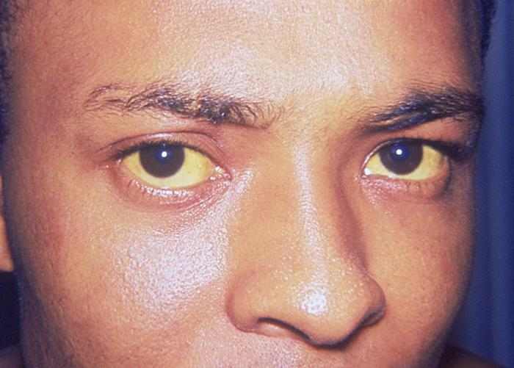
39 The family Flaviviridae
Micro #276 General and Molecular Virology
February 24, 2016
Positive-Sense RNA Viruses
From the Latin flavus, “yellow”
http://medicatoz.com/news/yellow-fever.html#.Uw4dMM5KZ2Q
Ikuo Tsunoda, MD, PhD
itsunoda@hotmail.com
Notes:
jaundice
/ˈdʒɔn dɪs

Slide 2
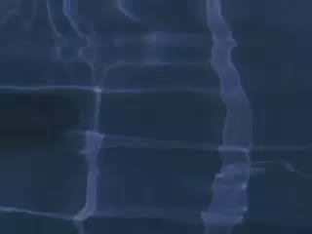
West Nile Virus: Human Diseases
http://www.cdc.gov/ncidod/dvbid/westnile/wnv_communityVideo.htm#clips

Slide 3
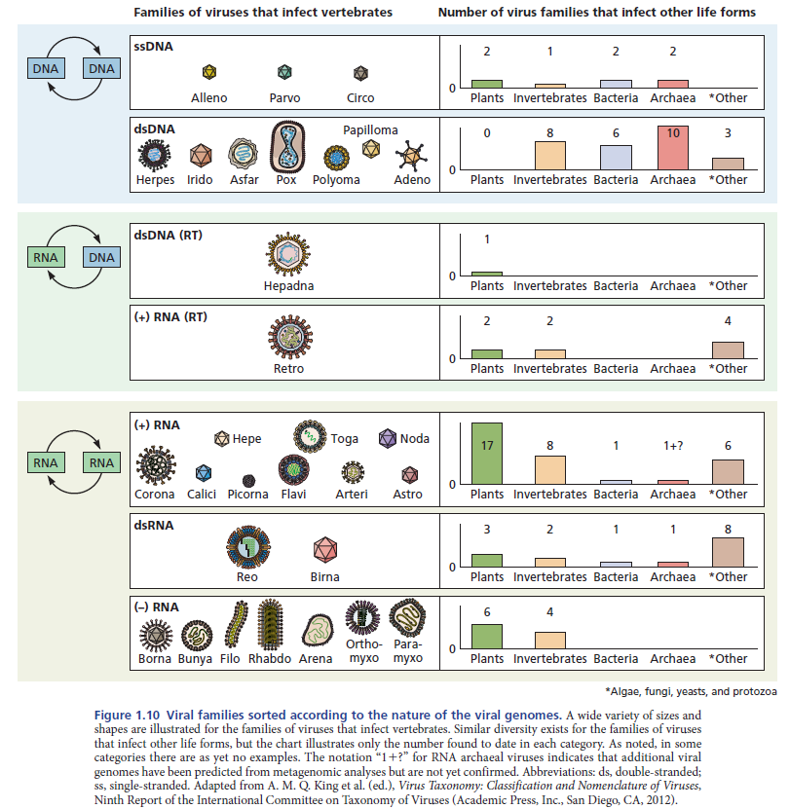

Slide 4
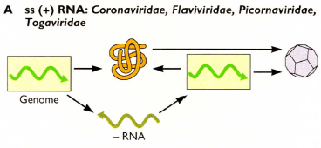
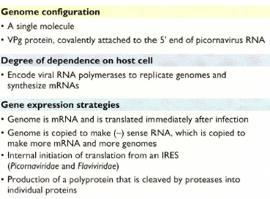
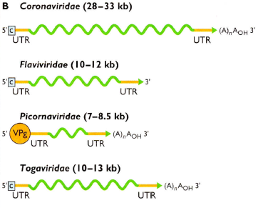
(+) strand RNA viruses

Slide 5
Positive-Sense Viruses
(e.g., Flaviviruses and Picornaviruses)
Polyprotein
Virion RNA
1.
Cell translation machinery
5'
(+) strand genomic RNA
(mRNA)
3'
c
for some flavi-
not picorna-
2.
New RdRp
3'
(–) strand complement
(antigenome)
5'
3.
New RdRp
5'
(+) strand genomic RNA
(mRNA)
3'
c
for some flavi-
not picorna-
Dr. Muggeridge

Slide 6
Introduction
Large family of related positive-sense RNA viruses
Separated from the family Togaviridae in 1986
Four genera
  Flavivirus (from Latin, flavus = yellow)
  Hepacivirus (from Greek, hepar, hepatos = liver)
  Pestivirus (from Latin, pestis = plague)
  Pegivirus, (“Pe” for persistent, “g” for “G” virus)
Share similarities in virion morphology, genome organization & presumed replication strategy
  All members lack a 3’-terminal poly(A) tract
  Translation of genome RNA: flavivirus, cap-dependent; others use IRES
Many of the family Flaviviridae are human and/or animal pathogens
Notes:
plague /pleɪɡ/ any serious disease that spreads quickly to a lot of people and usually ends in death
http://www.macmillandictionary.com/us/dictionary/american/plague

Slide 7
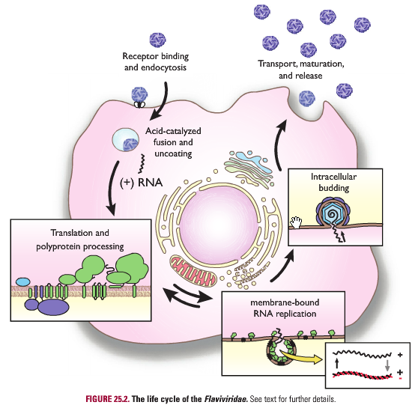
Characteristics & replication cycle
  Enveloped virions
    Lipid bilayer & 2 or more envelope (E) proteins
    Surrounds nucleocapsid made of capsid (C) monomers
    Contains positive polarity ssRNA genome complexed with C
  Binding, replication, budding
    Specific binding of E proteins to cell surface receptor
    Receptor-mediated endocytosis
    Viral envelope fuses with cell membrane
    RNA genome delivered into cytoplasm (3 roles)
      mRNA
      Template during replication
      Genetic material in virions
    RNA genome translated into single polyprotein
    Budding into ER, released at the cell surface by exocytosis

Slide 8
The genus Flavivirus

Slide 9
Background & classification
More than 50 species
Almost all arboviruses (arthropod-borne; Mosquito-borne & tick-borne viruses)
Many (40+) are human or veterinary pathogens
Those of major global importance include:
  Dengue virus (DEN)
  Yellow fever virus (YFV)
  Japanese encephalitis virus (JEV)
  West Nile virus (WNV)
  St. Louis encephalitis virus (SLEV)
  Tick-borne encephalitis virus (TBEV)
  Zika virus
There are vaccines for YFV, TBEV & JEV
  Need vaccines for others, especially DEN & WNV
There is no good treatment
  Ribavirin used with limited success

Slide 10
Yellow fever virus (YFV) history
The family Flaviviridae, genus Flavivirus
  YFV is the type species of the family Flaviviridae
  The “type species”: the virus initially necessitated the creation of the genus and best defines or identifies the genus
First filterable human pathogen (Walter Reed, 1901)
  Last US epidemic in New Orleans, 1905 (5,000 cases & 1000 deaths)
Causative agent isolated in 1928
First live-attenuated virus vaccine – 17D vaccine - in 1930’s
  Max Theiler won Nobel Prize

Slide 11
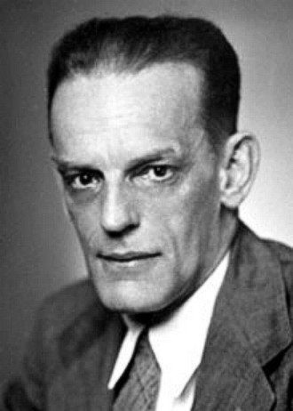
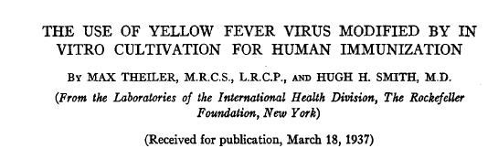
Max Theiler and yellow fever vaccine
Max Theiler, 1899-1972
Theiler M, Smith HH. The use of yellow fever virus modified by in vitro cultivation for human immunization. J Exp Med, 1937, 65; 787-800.
Nobel Prize in Physiology or Medicine, 1951
Max Theiler isolated Theiler’s murine encephalomyelitis virus, which belongs to the family Picornaviridae and is used for a mouse model for multiple sclerosis (Science 1934)
Oldstone book, p116

Slide 12
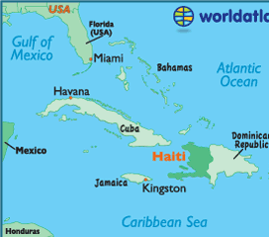
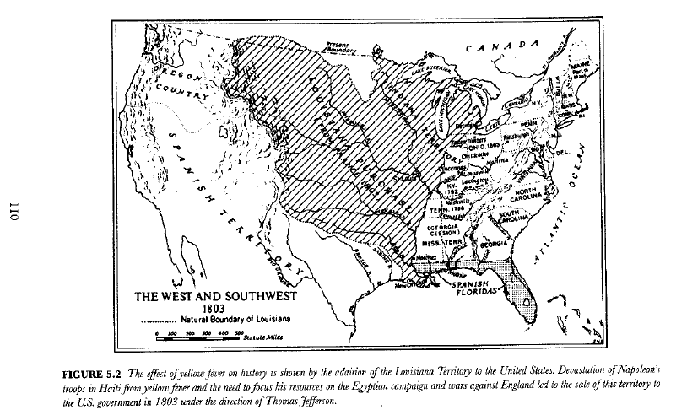
Chapter 5, Yellow fever, In: Virus, Plagues, and History by Michael Oldstone “yellow fever destroyed over 27,000 of the veteran French troops, including Napoleon’s brother-in-law, General LeClerc.,,,, Napoleon decided to sell the Louisiana Territory to the United State.”
Notes:
Haiti/ˈheɪ ti/
1. Formerly Hayti. a republic in the West Indies occupying the W part of the island of Hispaniola. 10,714 sq. mi. (27,750 sq. km). Capital: Port-au-Prince.
シャルル・ヴィクトール・エマニュエル・ルクレール（Charles Victor Emmanuel Leclerc, 1772年3月17日 - 1802年11月2日）は、フランス革命戦争・ナポレオン戦争期の軍人。ナポレオン・ボナパルトの妹ポーリーヌの最初の夫。

Slide 13
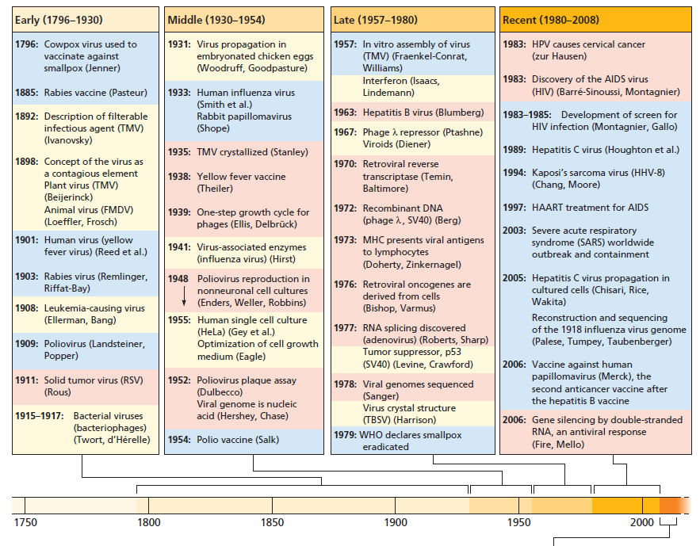
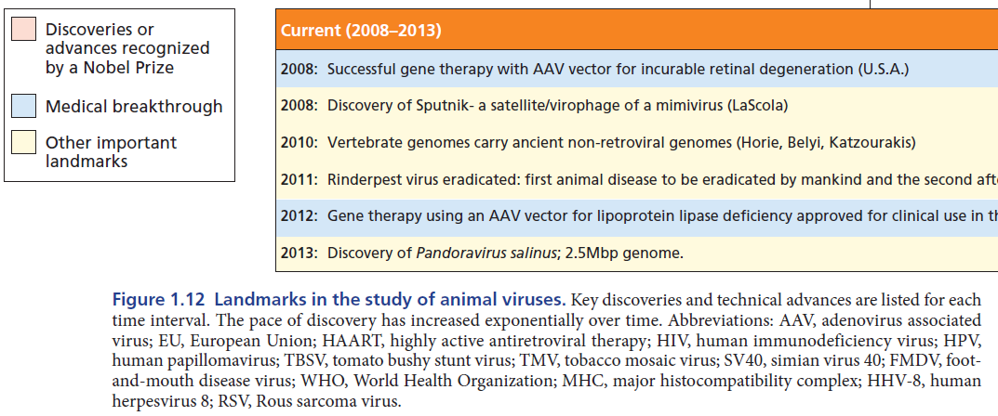

Slide 14
Febrile Illness with Arthralgia:
West Nile virus (WNV)
Dengue virus (DEN)
Hemorrhagic Fevers:
Yellow fever virus (YFV)
Dengue virus (DEN)
Encephalitis:
Saint Louis encephalitis virus (SLE)
West Nile virus (WNV)
Japanese encephalitis virus (JE)
Tick-borne encephalitis virus (TBE)

Slide 15
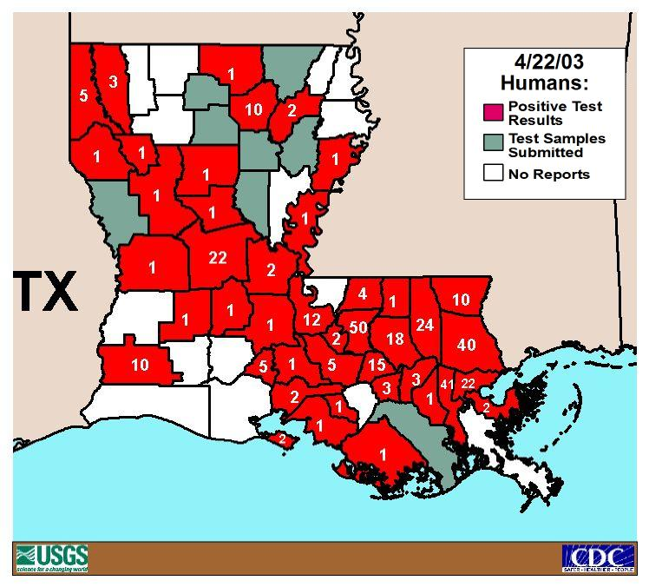
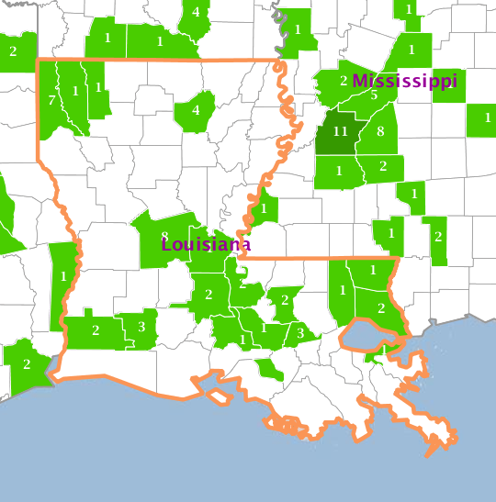
Human West Nile Virus Cases Louisiana
http://diseasemaps.usgs.gov/mapviewer/
No data
2002 Total
(329 cases)
2015 Total (43 cases)
^{(USA, total 2060)}

Slide 16
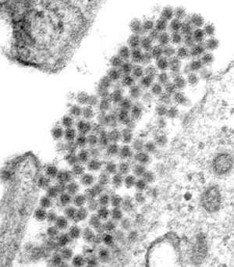
Structure & physical properties of the virion
Virions are spherical
  ~ 50 nm in diameter
Surrounded by lipid bilayer
  Readily inactivated by organic solvents or detergents
3 viral structural proteins
  Envelope (E)
    Surface protein
    Major antigenic determinant
    Mediates binding and fusion
  Membrane (M)
    Surface protein
    Made as precursor form (prM)
  Capsid (C)
Dengue virus particles

Slide 17
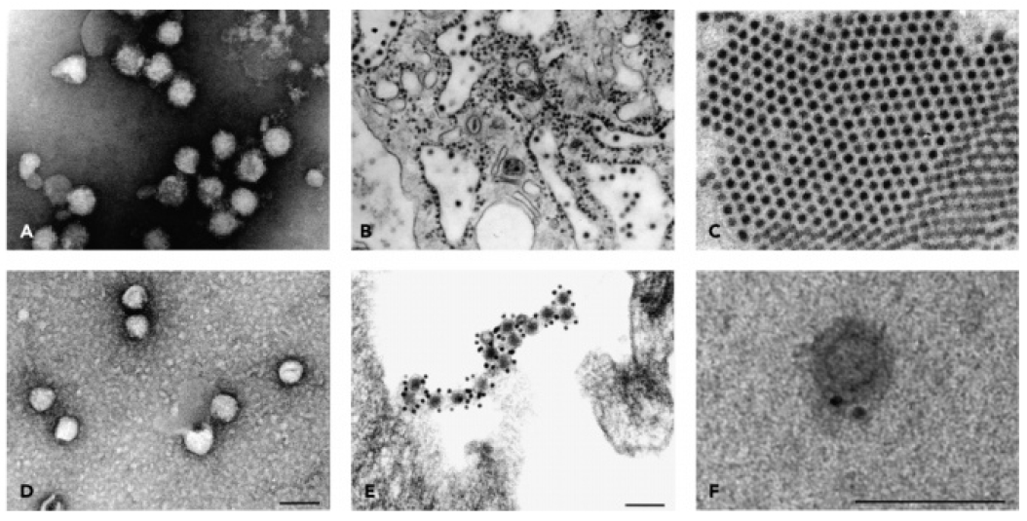
St. Louis encephalitis virus (SLE)
SLE in ER
SLE
Classical swine fever virus (CSFV)
CSFV immunostain
Hepatitis C virus (HCV) immunogold

Slide 18
Binding & entry (1)
E binds a receptor on the cell surface
  E-reactive antibodies neutralize infectivity by blocking binding
Multiple receptors for different cell types and in different host species
  Dengue virus, DC-SIGN (dendritic cell-specific intercellular adhesion molecule-3-grabbing nonintegrin)
  West Nile, DC-SIGNR (DC-SIGN related)
Several flaviviruses can bind & enter cells by antibody-dependent enhancement (ADE)
  Immunogloblin Fc receptor + cells

Slide 19
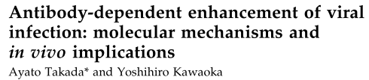
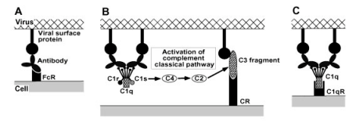
Antibody-dependent enhancement (ADE) of viral infection
Secondary dengue virus-2 infection after primary dengue virus-1 infection is a risk factor for dengue shock syndrome
Antibodies pre-existing from primary dengue virus infection enhance the replication of the second infecting dengue virus serotype
The virus-antibody complex can bind to cells bearing FcR (monocytes, macrophages, B cells and granulocytes) in flavivirus infection
Complement receptors involvement (flavivirus, HIV, Ebola virus)

Slide 20
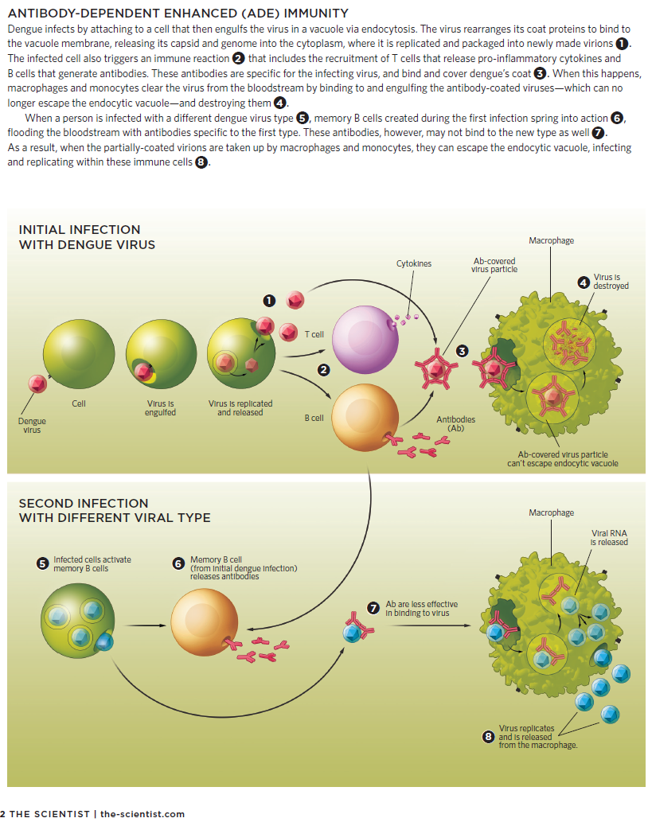
from neutralization, infecting

Slide 21
Antibodies are less effective in neutralizing virus

Slide 22
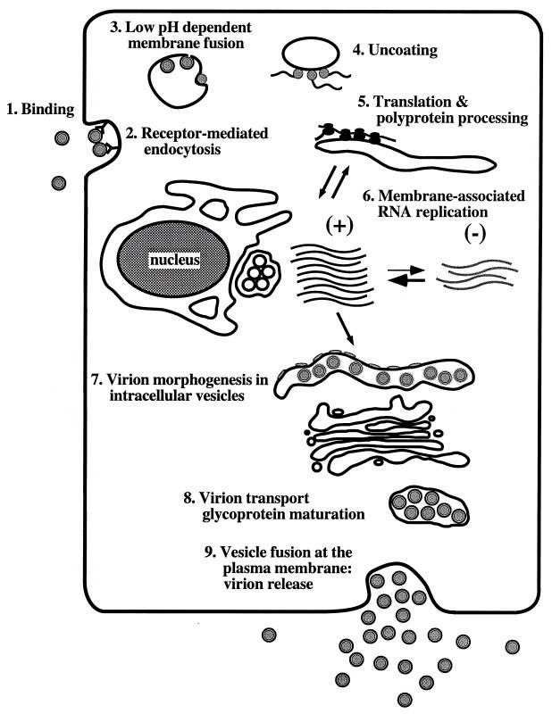
Binding & entry (2)
Single virions & virion aggregates seen in clathrin-coated pits on cell surface
  Taken up in coated vesicles
  Later seen in uncoated prelysosomal vesicles
Acid-catalyzed membrane fusion releases nucleocapsid into cytoplasm
  Low pH induces fusion between virus and host cell membranes to release the virus nucleocapsid
  Lipid composition can influence fusion
Presumably nucleocapsid disassembles
  Releases RNA genome for translation & replication

Slide 23
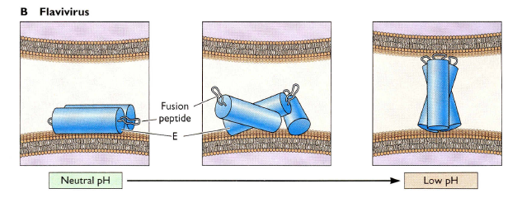
Low-pH-induced movement of flavivirus glycoprotein
The fusion peptide is buried in dimers of the fusion glycoprotein E
At low pH, the dimers are disrupted, the proteins rotate to form trimers
The fusion peptide is directed toward the cell membrane

Slide 24
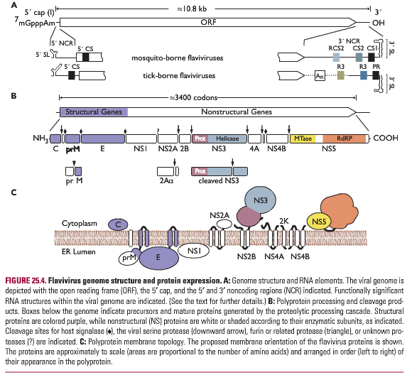
Envelope (E) glycoprotein
  Mediates receptor binding and membrane fusion
  Membrane glycoprotein anchored by 2 adjacent membrane-spanning domains
  3D structure determined by X-ray crystallography
    Three domains form head-to-tail homodimers
    Domain III; putative receptor binding site / target for neutralizing antibody
    Fusion peptide located at the tip of domain II
    Low pH dissociate E protein dimers into monomeric subunits, which then form trimers

Slide 25
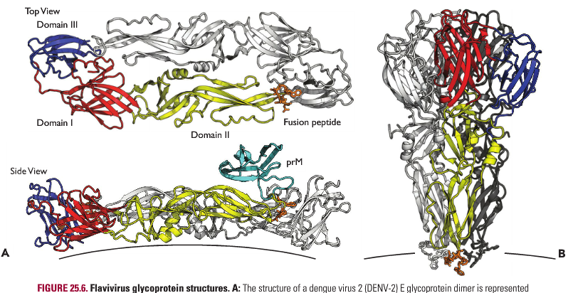
Dimer Trimer
E protein rearrangement
  At low pH E protein homodimers dissociate
  Monomers reassociate with 2 adjacent E proteins to form trimers
  Trimers thought to extend out from virion surface (exposes fusion domain?)
  Mutating the putative receptor binding site reduces infectivity, in vitro growth & in vivo virulence

Slide 26
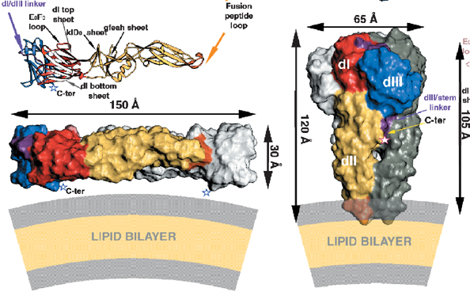
Viral fusion
From Christine Birdwell Spring Seminar Feb 24, 2011
Bressanelli S, Stiasny K, Allison SL, Stura EA, Duquerroy S, et al. (2004) Structure of a flavivirus envelope glycoprotein in its low-pH-induced membrane fusion conformation The EMBO Journal 23:728 - 738

Slide 27
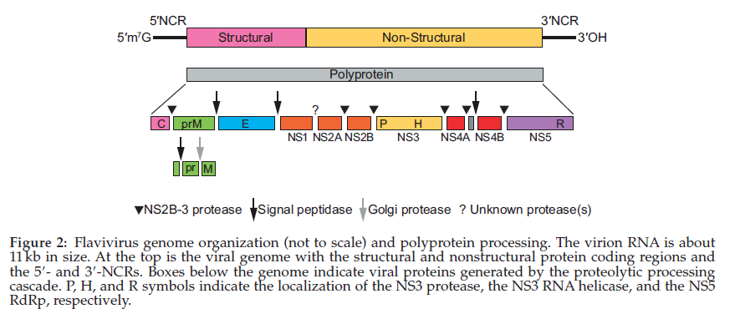

Genome structure
Genome is positive-sense ssRNA
  ~ 11 kb in length, has 5’ cap, lacks 3’ poly(A) tail
  Single long ORF with 5’ & 3’ noncoding regions (NCR) [or non-translated regions (NTR)]
Genus Flavivirus
p1006

Slide 28
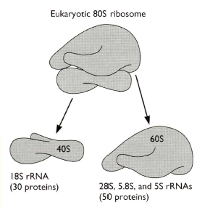
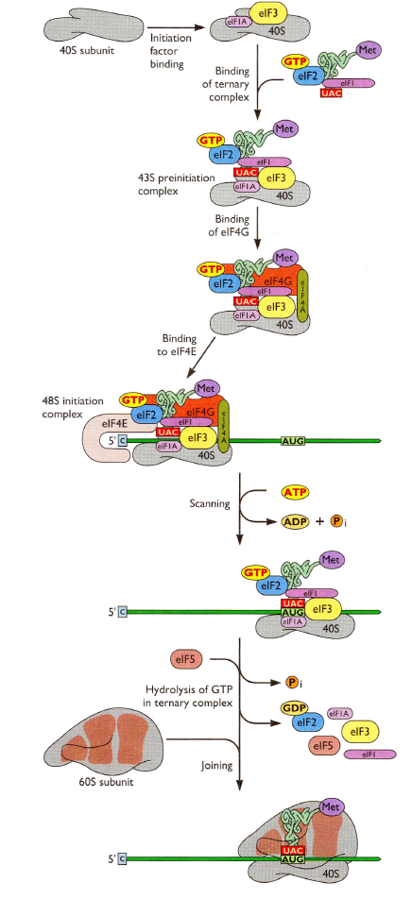
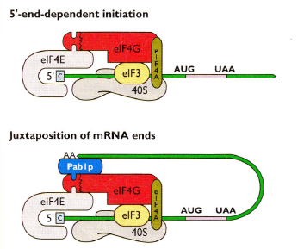
Translation machinery
In cap-dependent translation, initiation factors (eIF4F) , mediated by eIF4E, recognize the cap structure at the 5’end of mRNAs
Translation of mRNAs is efficient when there is an interaction between the 5’ cap structure and the 3’ poly (A) tail, by factors circularizing the mRNA
Notes:
eIF4 (eIF4F)
The eIF4 initiation factors include eIF4A, eIF4B, eIF4E, and eIF4G. eIF4F is often used to refer to the complex of eIF4A, eIF4E, and eIF4G.
eIF4G is a 175.5-kDa scaffolding protein that interacts with eIF3 (see below), as well as the other members of the eIF4F complex. eIF4E recognizes and binds to the 5' cap structure of mRNA, while eIF4G binds to Poly(A)-binding protein, which binds the poly(A) tail, circularizing and activating the bound mRNA.
eIF4A – a DEAD box RNA helicase – is important for resolving mRNA secondary structures. eIF4B contains two RNA-binding domains – one non-specifically interacts with mRNA, whereas the second specifically binds the 18S portion of the small ribosomal subunit. It acts as an anchor, as well as a critical co-factor for eIF4A

Slide 29
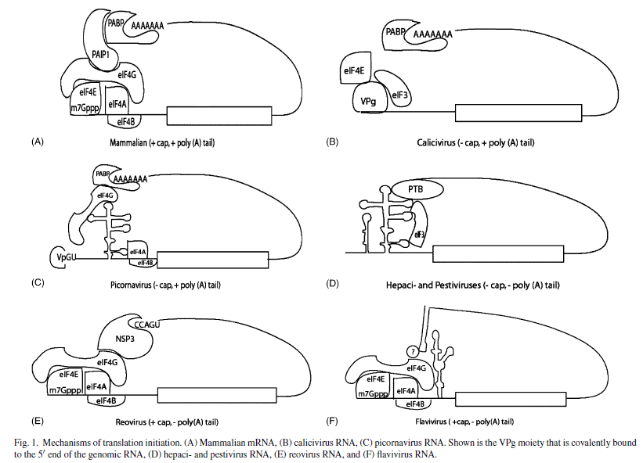

Communication between the 5’ and 3’ ends of mRNA enhances translation
For many mRNAs, the 5’-3’ linkage is mediated by the interaction of the eIF4G and the PABP (polyA binding protein), either directly or via the binding protein PAIP-1 (PABP-interacting protein)

Slide 30
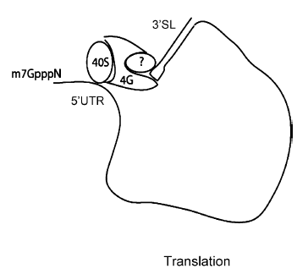
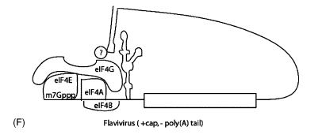
Although flaviviruses are not polyadenylated, 3’ stem loop (SL) recruits viral and cellular proteins, leading to 5’-3’ interaction and enhancing translation?
In the “closed-loop’ model of mRNA translation:
  1) the circularization stabilizes the mRNA and the translation complex
  2) ensures translation only of full-length RNAs that contains both the 5’ and 3’ ends
  3) promotes efficient recycling of ribosomes and rapid re-initiation of translation of the same strand of RNA
Notes:
Mammals can use polyA binding protein for cylization of mRNA because its mRNA contains poly A tail. However, flaviviruses do not have poly A tail. Instead they have other ways for cyclization of mRNA.

Slide 31
Translation & proteolytic processing
Genome translated as one polyprotein
  Cleaved co- and post-translationally
  Involves cellular proteases & a viral serine-protease
Polyprotein forms at least 10 discrete products
  N-terminal one quarter encodes structural proteins
  C-terminal three quarters encodes non-structural proteins
  C-prM-E-NS1-NS2A-NS2B-NS3-NS4A-NS4B-NS5

Slide 32
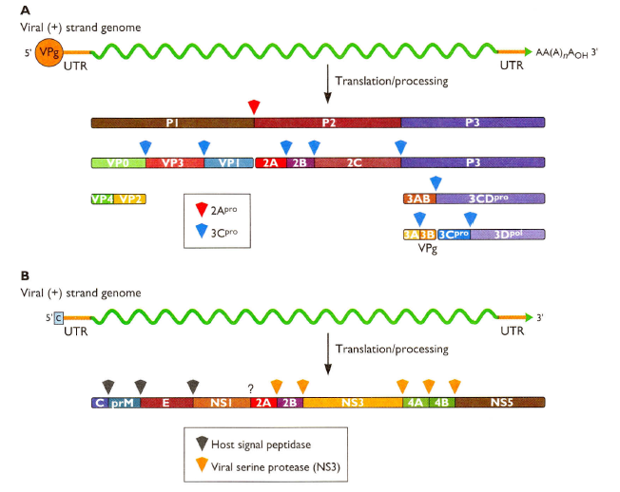
Polyprotein processing
A. Picornavirus: polyprotein is processed by two viral proteases
B. Flavivirus: processing is carried out by host signal peptidase or by the viral protease NS3
Strategy allowing the production of multiple proteins from a single RNA genome; polyprotein precursor is proteolytically processed to form functional viral proteins

Slide 33
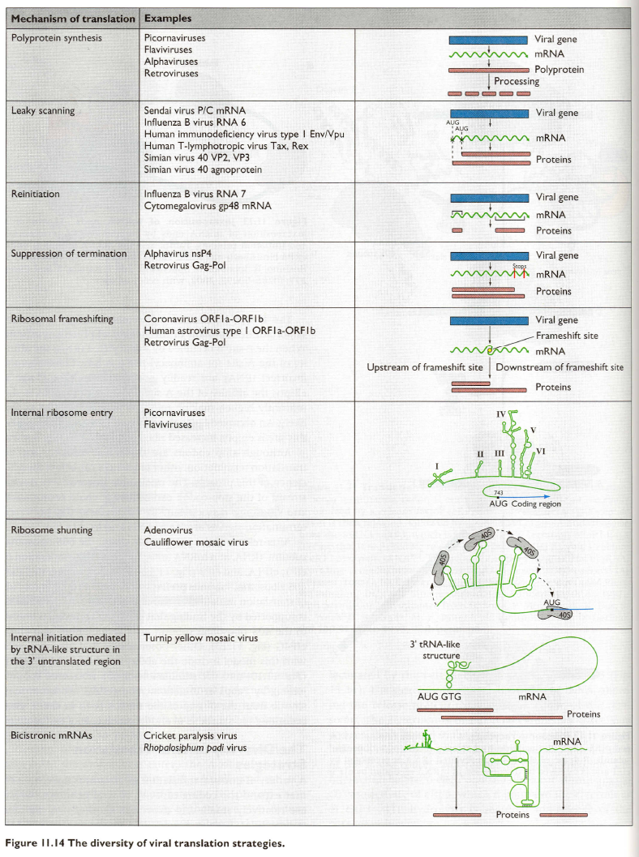
The diversity of viral translation strategies:
Polyprotein synthesis

Slide 34
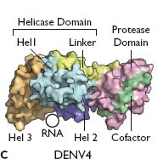
The NS3 protein
  Large cytoplasmic protein, associated with membranes through NS2B
  Required for polyprotein processing and RNA replication
    Has serine protease activity, ablated by mutating catalytic triad
    Expression of NS2B + <180 N-terminal aa’s of NS3 sufficient
  NS2B/NS3 mediates multiple cleavages of the viral polyprotein
    At NS2A/NS2B, NS2B/NS3, NS3/NS4A & NS4B/NS5 junctions
    To generate C-termini of mature C & NS4A proteins
  Helicase
  Induce apoptosis
    Dengue, West Nile
    Caspase-8 activation

Slide 35
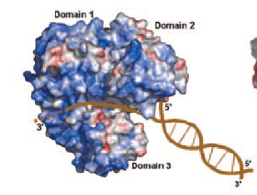

NS3 protein, Helicase: Unwinding the RNA template
Base-paired regions in viral RNA must be disrupted to permit copying by RNA-dependent RNA polymerase
Helicase prevents extensive base paring between template RNA and the complementary strand
Helicase is a potential target for chemotherapeutic intervention
Comprise three domains that mediate hydrolysis of nucleoside triphosphates and RNA binding
A cleft is large enough to accommodate single-stranded but not double stranded RNA
Unwinding occurs as one strand of RNA passes through the cleft and the other passes outside of the molecule

Slide 36
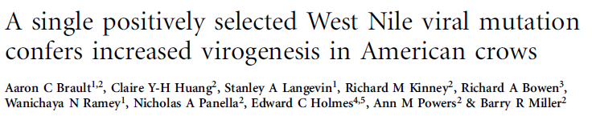
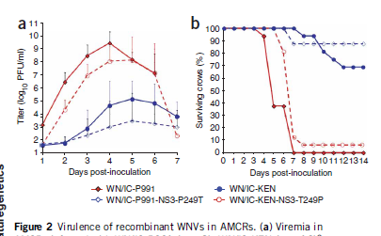
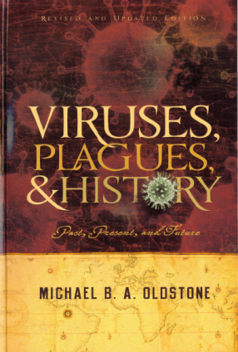
A single amino acid change in helicase of WNV explains the excessive susceptibility of the American crow
American crows are susceptible to North American strains of West Nile virus (WNV)
A change in a single amino acid of a threonine to a proline in the NS3 helicase gene of WNV enhances virulence in susceptible birds
New York virus mutant strain (WN/IC-P991) replicates 10,000- to 100,000-fold greater than nonmutant Kenyan virus strain (WN/IC-KEN) in the blood
The high level of virus in infected crows provides the best opportunity for a mosquito to become infected
  Maximize the opportunity for human infection
Oldstone book chapter 13
West Nile Virus: Death of Crows and Humans, p244-245

Slide 37
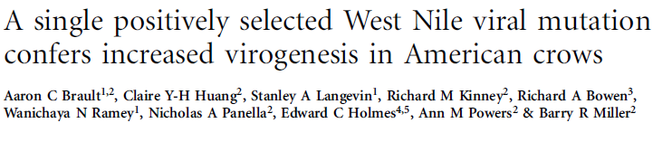
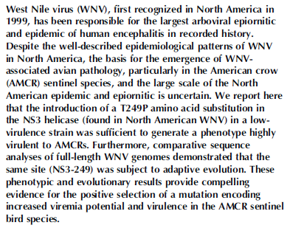
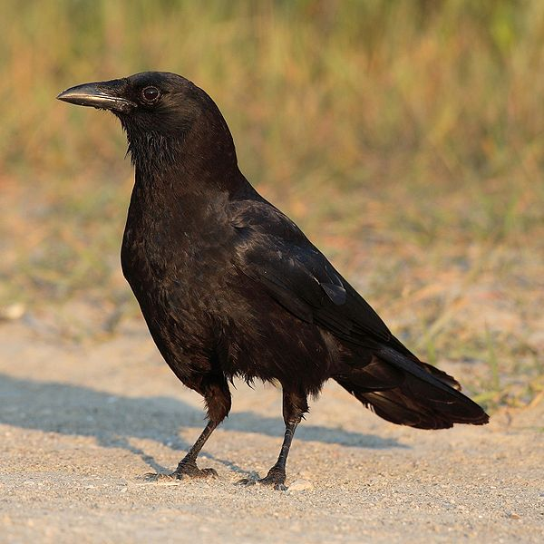
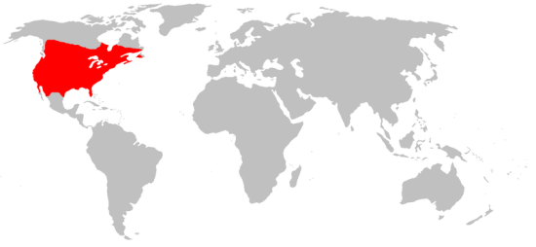
American Crow (Corvus brachyrhynchos)

Slide 38
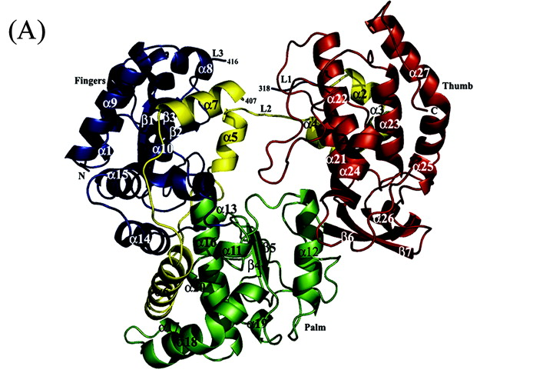
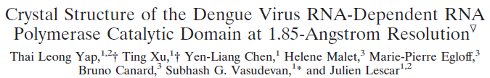
The NS5 protein
  Largest, most highly conserved flavivirus protein
  RNA-dependent RNA polymerase (RdRP) activity
  Purified recombinant NS5 has RdRp activity
  Methyltransferase activity
    Modification of the 5’ cap
    N7 methylation for viral translation and replication
    2’-O methylation to avoid innate antiviral defenses
  Dengue virus NS5 induces IL-8 transcription and secretion, which may enhance viral spread of disease by recruiting inflammatory cells to the site of infection
  NS5 blocks the Jak-STAT pathway of IFN signaling
Finger
Thumb
“right hand structure”
Palm

Slide 39
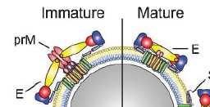

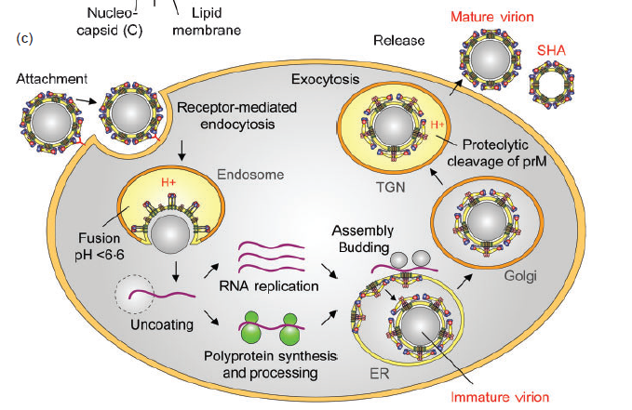
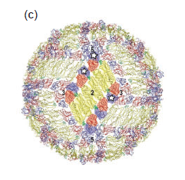
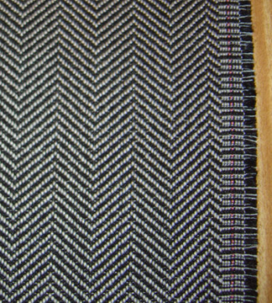
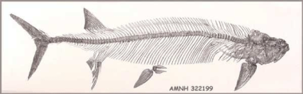
Flavivirus life cycle: RNA replication Assembly & release of progeny virus
E protein dimers in a herringbone-like arrangement
  Virus buds into lumen of ER
After uncoating, the plus-stranded RNA genome is translated to initiate virus replication
Virus assembly occurs in the endoplasmic reticulum (ER) and leads to the formation of immature (prM containing) particle that are transported through the exocytic pathway
The acidic pH in the trans-Golgi network (TGN) causes a conformational change in the prM-E complex that is required for the maturation cleavage by furin or a related protease

Slide 40


The 180 copies of E are tightly packed in a herringbone array that completely covers the lipid bilayer

Slide 41





ZIKV
EM of ZIKV, CDC
Zika Virus
Family: Flaviviridae
Genus: Flavivirus
First isolated in the Zika forest in Uganda in 1947
Zika means "overgrown" in the Luganda language.
Virology Journal Club, 02/12/2016, Lucile Guion

Slide 42




Transmission
The bite of an infected mosquito of the Aedes species
Suggested non-vector transmission
  Sexual intercourse
  Blood transfusions
  From mother to fetus
Thiboutot et al., 2010, PLoS Negl Trop Dis
Aedes aegypti
Aedes albopictus
Notes:
Zika, dengue, CHIKV… same type of symptoms (rash, fever, arthralgia, conjunctivitis…), not very serious, difficult to tell apart, 80% infected people are asymptomatic

Slide 43

Approximate known distribution of Zika virus, 1947–2007. Red circle represents Yap Island. Yellow indicates human serologic evidence; red indicates virus isolated from humans; green represents mosquito isolates.
Emerg Infect Dis. 2009 Sep; 15(9): 1347–1350.
doi: 10.3201/eid1509.090442
From John A. Vanchiere, M.D., Ph.D., Professor of Pediatrics
LSUHSC-S

Slide 44


With an estimated 440 000–1 300 000 cases currently in Brazil alone, Zika virus could be following in the footsteps of dengue and chikungunya, which are also transmitted by the Aedes aegypti mosquito. Given that an outbreak anywhere is potentially a threat everywhere, now is the time to step up all eff orts to prevent, detect, and respond to Zika virus. The Lancet

Slide 45
Clinical Features
80% no symptoms
Mild illness, resolve within 7 days: fever, malaise, skin rashes, conjunctivitis, muscle and joint pain, headache
Diagnosis: viral genome RT-PCR in blood, urine, amniotic fluid, serum antibody is not reliable because of extensive cross-reactivity against Dengue fever and Yellow fever viruses (Yellow fever have wide vaccine coverage)
Microcephaly in Brazil in 2015?
  4180 reported cases of microcephaly with suspected ZIKV association→732/4180 (17.5%) cases investigated → 270/732 (37%) confirmed cases with central nervous system malformations (if no CNS abnormality, it should not be microcephaly?)→ 6/270 (2.2%) were positive for ZIKV infection
  RT-PCR tests may not detect ZIKV RNA in a newborn who acquired ZIKV infection in utero if the period of viremia has passed
Notes:
symptoms = low grade fever, arthralgia, headache
Means that ZIKV can survive in semen and can thus be transmitted

Slide 46

ZIKV causes microcephaly?
20-fold increase in microcephaly rates in 2015 in Brazil
Reports of microcephaly in French Polynesia
Microcephaly: congenital condition associated with incomplete brain development and abnormal smallness of the head
Defined by a head circumference of more than 2 standard deviations below the mean
Seizures, developmental delay, intellectual disability, hearing loss, vision problems
Notes:
Usually chromosomal abnormalities
By the end of Nov 2015, 646 cases of microcephaly had been reported in 1 state

Slide 47

First and only the single case report of GBS
Day -7, a Polynesian woman in early 40s had an influenza-like syndrome, myalgia, rash, conjunctivitis
Day 0, neurological disorder onset: paresthesia of the four limbs
Day3, motor paralysis in four limbs, facial palsy, no deep tendon reflexes, tachycardia orthostatic hypotension
Neurophysiology: peripheral nerve demyelination suggested
Cerebrospinal fluid: increased protein, normal cell count
Treatment with intravenous polyvalent immunoglobulin
Day40: able to walk, muscular strength score 85/100
ZIKV were negative in her blood by RT-PCR (day 8)
ZIKA-specific IgM+ and IgG+ and Dengue-specific IgG+
Notes:
Probably immunological, like with other infectious agents

Slide 48
The genus Hepacivirus

Slide 49


By Dr Seongman Kim
Emily V. Stevenson
Hepatitis C virus (HCV)
Positive single-stranded RNA virus
Major cause of chronic liver disease and has chronically infected 3.2 million in the U.S. and 170 million worldwide (3% of world population)
Transmission principally via blood contaminated syringes
  Sexual and mother-to-child transfer are uncommon
About 80% of newly infected patients progress to develop chronic infection. Cirrhosis develops in about 10% to 20% of persons with chronic infection, and liver cancer develops in 1% to 5% of persons with chronic infection over a period of 20 to 30 years
Chronic
hepatitis

Slide 50

By Dr. Ru Jiang

Slide 51

By Dr Seongman Kim
Composition of Hepatitis C Virus
Lipid Envelope
Capsid Protein
Nucleic Acid
Envelope Glycoprotein E2
Envelope Glycoprotein E1
Courtesy Michael Gale via Tenille Gale
Notes:
51

Slide 52



From Emily V. Stevenson, Journal Club 011813
Notes:
52

Slide 53

Diagnostic Tests
By Dr. Ru Jiang
Diagnostic tests for HCV are divided into two broad categories:
Tests to assess damage to the liver: serum alanine aminotransferase (ALT);
Tests to identify the type and amount of the hepatitis virus
Antibody to HCV tends to arise late
Course of acute HCV
Course of acute HCV evolving
into chronic infection
Treatment
Combination therapy with pegylated (time-release) interferon-α and ribavirin is the most effective treatment for people with HCV. Duration and sensitivity of treatment depends on the HCV genotype, viral load, and patients conditions
New clinical trial: NS5A replication complex inhibitor daclatasvir and NS3 protease inhibitor asunaprevir
Notes:
これまで標準的にＣ型肝炎の治療に使われてきたインターフェロンが注射薬だったのに対して、新薬は飲み薬という点が画期的。その第一弾は2014年９月に 発売されたアスナプレビルとダクラタスビルの２剤の組み合わせだ。国内での臨床試験では、６カ月飲み続けた患者の84.7％でＣ型肝炎ウイルスが６カ月に わたって体内から消えた。しかも、この中にはインターフェロンが効かなかった患者も含まれる。
http://www.nikkei.com/article/DGXMZO82493260Y5A120C1000000/

Slide 54
Background & classification
Hepatitis C virus (HCV) identified in 1989
  etiologic agent to cause non-A non-B viral hepatitis
  Member of the genus Hepacivirus, which may contains GB virus B and canine hepacivirus (CHV)
  Seven genotypes
  There is no known invertebrate vector
HCV is difficult to work with;
  Infectious HCV in cell culture (HCVcc) developed in 2005
    JFH1, an HCV isolate from fuluminant hepatitis in Japan, in human hepatoma cell line (Huh-7)
  The chimpanzee remains the only animal model
  Human liver transplant in mice
    Mice with implanted ectopic human liver grafts
    Mice with liver injury and human hepatocyte xenografts
    Humanized mice

Slide 55





From Donna Collins
Virology Journal Club
Feb 07, 2014

Slide 57

Structure & physical properties of the virion
Virions are 30 to 80 nm in diameter
  based on filtration and electron microscopy (EM)
Virus particles shown by EM
  Pooled human plasma
  Hepatocytes from infected chimpanzees
  Produced in cell culture
Potential interaction with lipoproteins
3 viral structural proteins have been identified
  C (core) protein
  2 membrane glycoproteins, E1 & E2

Slide 58

Binding & entry
HCV infects hepatocytes through a multistep process that involves several cell surface molecules:
  CD81 (tetraspanin)
  Low-density lipoprotein receptor (LDL-R)
  Scavenger receptor class B type I (SR-BI)
  Claudin 1 (CLDN1)
  Occuldin (OCN)
  Glycosaminoglycans
Endocytosis, acidification of the endosomal compartment

Slide 59

Genome structure
Genome is positive-sense ssRNA
  9.6 kb in length
5’ NCR has IRES activity
  Internal ribosome entry site, IRES
  Directs cap-independent initiation of translation of the single large ORF
3’NCR has
  Short variable domain and a polyuridine / polypyrimidine (polyU/UC) tract
  Cellular factors bind to the HCV 3’NCR, including PTB and La antigen
Notes:
ピリミジン塩基はチミン，シトシン，ウラシル，5‐メチルシトシン，5‐(ヒドロキシメチル)シトシンのいずれかを指し、DNA 中ではシトシンとチミンが，RNA 中ではシトシンとウラシルが含まれる。

Slide 60

Information retrieval from viral genomes: Different strategies for decoding the information in viral genomes
I.R.E.S. Database
http://www.rangueil.inserm.fr/IRESdatabase/

Slide 61


5’-end dependent versus independent translation
Two mechanisms by which ribosomes bind to mRNA
Cap-dependent translation
  The initiation complex binds to the 5’ cap structure and moves until the initiation AUG codon is encountered
IRES-dependent translation
  Ribosome binds the internal ribosome entry site (IRES), rather than at the mRNA 5’ end

Slide 62

IRES types
IRESs contain extensive regions of RNA secondary structures; five groups
A, type 1, poliovirus
B, type 2, aphtoviruses and cardioviruses
C, type 3, hepatitis C virus. The 3’ end of the IRES extends beyond the AUG initiation codon
D, type 4, cricket paralysis virus (the family Dicistroviridae)

Slide 63

5’-end-independnet initiation
Different translation initiation proteins are required for various IRESs
Initiation of the type I or II IRES requires eIF4G to recruit the 40S ribosomal subunit
Ribosomal 40S subunit binds directly to hepatitis C virus IRES without translation initiation proteins; eIF3 binds to the IRES and is necessary for recruitment of the 60S ribosomal subunit

Slide 64

Complex of the 40S ribosomal subunit with the hepatitis C virus IRES
IRES binding induces a conformational change in the 40S subunit and closes the mRNA binding cleft

Slide 65

Hepatitis C Virus IRES RNA-Induced Changes in the Conformation of the 40S Ribosomal Subunit
C.M.T. Spahn, J.S. Kieft, R.A. Grassucci, P.S. Penczek, K.Zhou, J.A. Doudna, J. Frank
http://www.sciencemag.org/content/suppl/2001/03/07/291.5510.1959.DC1/1058409.mov
Science. 2001 Mar 9;291(5510):1959-62.

Slide 66

End-to-end communication in the modulation of translation
The HCV is not polyadenylated at its 3’ end
The HCV IRES interact with PTB (polypyrimidine tract binding protein), which can bind to both the IRES and the 3’end of the RNA
The multimerized PTB may circularize the HCV genome by binding to both ends of the RNA
Notes:
ピリミジン塩基が連続する領域(ポリピリミジン配列 polypyrimidine tract)
ポリピリミジントラクト結合タンパク質(PTB)は真核生物のタンパク質であり、4つ のRNA結合領域(RBDs)を用いてUCに富む RNA基質に結合し、メッセンジャーRNAのス プライシングに重要な役割を果たしている。

Slide 67
Translation & proteolytic processing
Genome translated as one polyprotein
  Processed co- & post-translationally
  Involves cellular proteases and two virus-encoded proteases (NS2 cysteine autoprotease and NS3-4A serine protease)
Polyprotein forms 10 discrete products
  N-terminal one quarter encodes structural proteins
  C-terminal three quarters encodes non-structural proteins
  C-E1-E2-p7-NS2-NS3-NS4A-NS4B-NS5A-NS5B

Slide 68

Genome structure
Notes:
Serine proteases (or serine endopeptidases) are enzymes that cleave peptide bonds in proteins, in which serine serves as the nucleophilic amino acid at the (enzyme's) active site.^{[1]} They are found ubiquitously in both eukaryotes and prokaryotes. Serine proteases fall into two broad categories based on their structure: chymotrypsin-like (trypsin-like) or subtilisin-like.^{[2]} In humans, they are responsible for co-ordinating various physiological functions, including digestion, immune response, blood coagulation and reproduction.^{[1]}
Signal peptidases are enzymes that convert secretory and some membrane proteins to their mature forms by cleaving their signal peptides from their N-terminals.
In molecular biology, the Signal Peptide Peptidase (SPP) is a type of protein that specifically cleaves parts of other proteins. It is an intramembrane aspartyl protease with the conserved active site motifs 'YD' and 'GxGD' in adjacent transmembrane domains (TMDs). Its sequences is highly conserved in different vertebrate species. SPP cleaves remnant signal peptides left behind in membrane by the action of signal peptidase^{[1]} and also plays key roles in immune surveillance and the maturation of certain viral proteins .^{[2]} Physiologically SPP processes signal peptides of classical MHC class I preproteins. A nine amino acid-long cleavage fragment is then presented on HLA-E receptors and modulates the activity of natural killer cells.^{[3]}
SPP also plays a pathophysiological role; it cleaves the structural nucleocapsid protein (also known as core protein) of the Hepatitis C virus and thus influences viral reproduction rate.^{[4]}

Slide 69



DAAs: direct-acting antiviral agents
protease inhibitors; -previr
NS5A inhibitors; -asvir
polymerase inhibitors; -buvir

Slide 70



GBV-B categorized within the genus Hepacivirus
GB virus B
GBV- causes self-limiting liver disease in New World monkeys species, including tamarins, marmosets, and owl monkeys, primate virus models
No infection in humans or chimpanzees
Emperor tamarin
Common Marmoset (Callithrix jacchus)
Owl (or Night) Monkey (Aotus trivirgatus)

Slide 71
Genus Pestivirus

Slide 72


Background & classification
Animal pathogens of major economic importance
  Bovine viral diarrhea virus (BVDV)
  Classical swine fever virus (CSFV) in pigs
    Hog cholera, constipation followed by diarrhea, generalized vasculitis, hemorrhages
  Border disease virus (BDV) in sheep
    Hairy shaker disease, infection of the fetus, abortion, low birth weight, myelin deficiency (https://www.youtube.com/watch?v=AnO-L02PcDg, Pestivirus infection in chamois)
Greater similarity to hepaciviruses than flaviviruses
IRES
No poly(A) tract
Notes:
Border disease (Britain) or hairy shaker disease (Australia and New Zealand) is a congenital disorder of lambs characterized by low birth weight and viability, poor conformation, tremor, and an excessively hairy birth coat in normally smooth-coated breeds. Kids may also be affected, and a similar condition occasionally occurs in calves. The disease has been recognized in most sheep-rearing areas of the world, including the western USA.

Slide 73


RNA recombination; origin of diversity in RNA virus genomes
Recombination; the exchange of nucleotide sequences among different genomic RNA molecules
Recombination, a feature of many RNA viruses, is an important mechanism for producing new genomes with selective growth advantages
Replicase-driven template switching model, the RNA breakage and ligation model, and the breakage-induced template switching model
Template switching
The RNA polymerase (purple) has copied the 3’ end of the donor genome and is switching to the acceptor genome

Slide 74


Recombination: distinct mechanisms for DNA and RNA viruses
Recombination is a process in which nucleic acid sequences from two genotypically different parental viruses are exchanged so progeny contain sequences from both
For RNA viruses with nonsegmented genomes:
Occurs during replication by switching templates so the newly synthesized genome contains sequence from two different parental molecules (“copy choice” recombination)
Nonsegmented RNA virus
RNA being copied by polymerase switches from one RNA molecule (donor template) to another (the acceptor template)
Thought to be guided by sequence similarity of the nucleic acid molecules
Does NOT involve breaking of viral RNA molecules
Daughter RNA molecule has mixed ancestry (RNA from two different genomes)
Has been described for picornaviruses (e.g. polio), coronaviruses, and retroviruses (e.g. HIV)
Dr. Arnold lecture 2/21/15
Notes:
Nat Rev Micro (2011) 9: 617-626.

Slide 75

RNA recombination leading to the production of pathogenic viruses
Infection of a fetus with bovine viral diarrhea virus is noncytopathic
RNA recombination produces a cytopathic virus that causes severe gastrointestinal disease after the animal is born
RNA recombination reactions add an extra protease cleavage site in the viral polyprotein, at the N terminal of the NS3 protein

Slide 76
Most notable features…
Genome is ssRNA of ~12 kb
  Cap-independent translation initiation of the viral genome is mediated by an IRES
  Lacks a 5’cap and 3’ poly(A) tract (similar to HCV)
  N^{pro}-C-E^{rns}-E1-E2-p7-NS2-NS3-NS4A-NS4B-NS5A-NS5B
First protein translated is N^{pro}
  Autoprotease, cleaves N^{pro}/C
Have 3 envelope glycoproteins
  E1 & E2
  Plus E^{rns} (ribonuclease, soluble)
    Has ribonuclease activity
    If site mutated virus is more cytopathic in culture, but attenuated in vivo

Slide 77

Genus Pegivirus
“Pe” for persistent and “g” for “G” virus, in historical reference to GB virus and hepatitis G virus
Pegivirus A infects New World primates (formerly described as GBV-A), humans (formerly GBV-C or hepatits G virus) and chimpanzees, and Old World monkey species
Pegivirus B infects bat species Pteropus giganteus (Indian flying fox)

Slide 78



http://www.nature.com/news/distinctive-virus-behind-mystery-horse-disease-1.12624

Slide 79

Pegivirus, a new fourth genus
The family Faviviridae
Isolated from a surgeon (George Barker) with acute non A-non B hepatitis
GBV-A (New world monkey), GBV-C (human and chimpanzee), and GBV-D (fruit bat)
GBV-C, initially termed “hepatitis G virus (HGV),” but it rarely, if ever, causes hepatitis
Flaviviridae
P1018-9
GBV-A, C, D
GBV-B
Pegivirus

Slide 80


http://ictvonline.org/proposals/2012.011a-dV.A.v2.Pegivirus.pdf
http://ictvonline.org/virusTaxonomy.asp?taxnode_id=20130584

Slide 81
Questions
Explain “Antibody-dependent enhancement (ADE) of infection”, by drawing below in figure(s) and using the keywords: Dengue virus, Fc receptor, neutralization
Describe the Nobel Prize award in flavivirus research: name of the person, virus, and discovery (Hint, “flavus” in Latin. The same person isolated the virus used for a viral model of multiple sclerosis)
Communication between the 5’ and 3’ ends of mRNA can enhance translation in some viral infections [e.g. the genera Flavivirus and Hepacivirus (HCV)]. Describe it, by drawing below in figure(s) and the keywords: IRES, cap, polyA, 3'UTR, 5'UTR, and circularization

Slide 82





Slide 83



Slide 84


Slide 85


Slide 86


Slide 87


Slide 88


Slide 89


Slide 90


Slide 91


Slide 92


Slide 93
Structure of the 5’ NCR
~100 nt of poorly conserved sequence
5’ NCR in genomic strand contains common secondary structures
  Antisense compound to 5’-stem loop viral RNA translation and replication
The complementary region of the negative strand serves as a site of initiation for positive strand synthesis during RNA replication
  Deletions in this region were lethal in Dengue virus 4 replication
  May also influence host-range
  Human protein, including La and TIAR, can bind to the 3’NCR of minus strand RNA

Slide 94
Structure of the 3’ NCR
High divergence in sequence & length (400-700 nt)
But, have common features
Long stem-loop in 3’ NCR of all flaviviruses
  Antisense compound to 3’-stem loop inhibit virus translation and replication
  If mutated reduces infectivity & limits host range
  Viral replicase proteins NS3 & NS5 bind here
  Several cellular proteins bind here
    Including the human LA autoantigen
Conserved portion of 3’ NCR contains consensus sequences
  Common to all mosquito-borne flaviviruses
  CS1 basepairs with a complementary sequence (5’CS)
Other conserved sequences, CS2 and RCS2
  Virus with deletion, highly attenuated

Slide 95

Capsid (C) protein
  Positively charged and hydrophobic
    RNA binding and membrane interaction
  Basic residues concentrated at N- & C-termini
    Act cooperatively to bind RNA?
  Hydrophobic domain in center
    Interacts with cellular membranes
  Nascent C protein (anchC) has C-terminal hydrophobic signal sequence for translocation of prM into ER lumen

Slide 96

Membrane glycoprotein prM
  Prevent E from undergoing acid-catalyzed rearrangement to the fusogenic form during transit through the secretory pathway
  N-terminus generated in ER lumen by host signal peptidase and requires prior processing of anchC by cytoplasmic viral protease
  Improving context of signalase site lethal for virion production so protease activity may regulate structural protein processing
  Immature intracellular virion assembled with prM protein
  In mature extracellular virion M cleaved by trans-Golgi enzyme furin during egress through secretory pathway and “pr” secreted

Slide 97


Slide 98
Nonstructural protein, NS1
  Cell-associated, cell-surface or extracellular (nonvirion) glycoprotein
  Translocated into ER lumen and cleaved from E by signal peptidase
  Cleaved from NS2A by unknown membrane-bound, ER-resident host protease
  Forms homodimers
  Extracellular NS1 elicits strong, protective antibodies
  NS1 has an important yet unclear role in RNA replication

Slide 99
The NS2A & NS2B proteins
  NS2A is a small hydrophobic protein
    NS1-NS2A cleavage in ER & NS2A-NS2B cleavage by cytoplasmic serine protease –
    Role in RNA replication and virus assembly
    Interferon antagonist
  NS2B also small, membrane-associated protein
    2 hydrophobic domains surround conserved hydrophilic region
    Forms complex with NS3
    Acts as a cofactor for the serine protease function of NS3

Slide 100
The NS4A & NS4B proteins
  Both small, hydrophobic, membrane-associated proteins
  NS4A interacts with NS1 and probably has role in RNA replication
  NS4A and NS4B can block type I IFN signaling
  NS3/NS4A cleavage mediated by NS2B-3 protease

